Slide 1


ITM 540
Data Networks
The Network Layer
Layer 3
The IP Layer - Addressing
Professor: Carol Davids
Email: davids@iit.edu
Carol Davids © 2009

Slide 2
Reading Assignment
Forouzan :
Chapter 19: Host to host delivery: Internetworking, Addressing, and Routing
Carol Davids © 2009

Slide 3
Terminology
Network Address
Network Mask
Classfull addressing
Classless addressing
Net ID
Host ID
Block of Addresses
Carol Davids © 2009

Slide 4
IP Addressing
The IP Address (layer 3 address) ( network address) is associated with a computing device that is a member of The Internet community.
It uniquely identifies the device on The Internet.
It is analogous to a telephone number.
Carol Davids © 2009

Slide 5
IP Addressing – IPv4
The IP Address field of the IPv4 datagram header is 32 bits long.
We visualize it as 4 bytes, each byte separated from the next by a period or dot (.)
For example: 216.47.140.27
Carol Davids © 2009
Notes:
Decimal.decimal focus this address

Slide 6
IP Addressing – IPv6
The IP Address field in the IPv6 datagram header is 128 bits long.
We visualize it as 8 groups of 2-byte units
For example:
FDEC:0074:0000:0000:0000:B0FF:0000:FFFF
128 bits = 2⁷ bits = 2³ * 2⁴ bits = 8 groups of 16 bits each – or 8 groups of 2-byte units.
Carol Davids © 2009

Slide 7
IP v4 Addressing
There are a total of 2³² = 4,294,967,296 different patterns that can be created using 32 bits.
So there are 4,294,967,296 different devices that can be uniquely addressed on the Internet. (over 4 billion)
Carol Davids © 2009

Slide 8
IP Addressing
Notice that if a host or router has two separate connections to the Internet then it will need two separate IP Addresses.
Routers by definition need to have more than one connection to the Internet.
Carol Davids © 2009

Slide 9
Binary Notation
The IPv4 address is read by network equipment as a set of 4, 8-bit bytes or octets.
10000000 00001011 00000011 00011111
Carol Davids © 2009

Slide 10
Dotted Decimal Notation
Each octet can be expressed as a decimal number.
10000000 00001011 00000011 00011111
By convention is represented as
128.11.3.31
Carol Davids © 2009

Slide 11
128 64 32 16 8 4 2 1
1 0 0 0 0 0 0 0 = 128
128 64 32 16 8 4 2 1
0 0 0 0 1 0 1 1 = 11
128 64 32 16 8 4 2 1
0 0 0 0 0 0 1 1 = 3
128 64 32 16 8 4 2 1
0 0 0 1 1 1 1 1 = 31
Carol Davids © 2009

Slide 12
How to solve IP address problems
Translating dotted decimal to and from binary notation.
Example 1 in text book.
Example 2 in text book.
Example 3 in text book
Carol Davids © 2009

Slide 13
Example 1
Change the following IP addresses from binary notation to dotted-decimal notation.
a. 10000001 00001011 00001011 11101111
b. 11111001 10011011 11111011 00001111
Carol Davids © 2009

Slide 14
Example 1
Replace each group of 8 bits with its equivalent decimal number and add dots for separation:
a. 129.11.11.239
b. 249.155.251.15
Carol Davids © 2009

Slide 15
Example 2
Change the following IP addresses from dotted-decimal notation to binary notation.
a. 111.56.45.78
b. 75.45.34.78
Carol Davids © 2009

Slide 16
Example 2
Replace each decimal number with its binary equivalent :
a. 01101111 00111000 00101101 01001110
b. 01001011 00101101 00100010 01001110
Carol Davids © 2009

Slide 17
Example 3
What’s wrong with these addresses?
  11.028.39.25
  221.34.7.8.20
  176.100.426.14
Carol Davids © 2009

Slide 18
Example 3
What’s wrong with these addresses?
  11.028.39.25
  221.34.7.8.20
  176.100.426.14
Carol Davids © 2009

Slide 19
IPv4 Address – Base 2
Remember that an IPv4 address is a string of 32 bits
We impose logic onto that string of bits – giving groups of bits special meaning
We interpret each bit to be the coefficient of a power of 2 (2^{n}, where n represents the position of the coefficient when you count from right to left starting with 0)
Review of binary notation is on page 1038 in text book.
Carol Davids © 2009

Slide 20
IPv4 Address – Base 256
The dotted-decimal notation is a way to represent an IPv4 address in ‘Base-256’ instead of in Base-2.
For example, 64.131.110.25 can be interpreted to mean:
64 (256³) + 131 (256²) + 110(256¹) + 25 (256⁰)
Page 1040 on the text book provides an example calculation.
Carol Davids © 2009

Slide 21
Blocks of IP addresses
We assign blocks of addresses to networks
The blocks of addresses are given to Internet Service Providers (ISP)
The ISPs in turn can further divide their blocks of addresses into smaller blocks and sell these to smaller service providers or to enterprises and individuals
Carol Davids © 2009

Slide 22
Blocks of addresses in addressing schemes
ICANN - the Internet Corporation for Assigned Names and Addresses – provides blocks of IP addresses to Internet Service Providers
Carol Davids © 2009

Slide 23
Classfull vs. Classless addresses
There are two ways to represent IPv4 addresses
Classful and classless
Classful addressing assigns classes to blocks of IP addresses based on the value of the high-order byte
Carol Davids © 2009

Slide 24
Classful Addressing
The IP address space is divided into five classes, designated:
  Class A
  Class B
  Class C
  Class D
  Class E
Carol Davids © 2009

Slide 25

Classful Addressing
Routers read the leading bits
Humans remember the range of values of the leading byte (Figure 19.12)
Carol Davids © 2009
Notes:
Net id(important) host id
8bit 8bit, 8bit, 8bit
Memorize!

Slide 26
Classful Addressing example
What is the largest number that can be represented by this string of bits?
0xxxxxxx (where x represents a bit, and a bit can have one of two values, 0 or 1)
0(2⁷) + 1(2⁶) + 1(2⁵) + 1(2⁴) + 1(2³) +1(2²) + 1(2¹) + 1(2⁰)
0 + 64 + 32 + 16 + 8 + 4 + 2 + 1 = 127
What is the smallest number that can represented by that same string of bits?
0(2⁷) + 0(2⁶) + 0(2⁵) + 0(2⁴) + 0(2³) + 0(2²) + 0(2¹) + 0(2⁰)
Carol Davids © 2009

Slide 27
Example 19.4
Find the class of each address.
a. 00000001 00001011 00001011 11101111
b. 11000001 10000011 00011011 11111111
c. 14.23.120.8
d. 252.5.15.111
Carol Davids © 2009

Slide 28
Example 19.4
Solution
a. The first bit is 0. This is a class A address.
b. The first 2 bits are 1; the third bit is 0. This is a class C
address.
c. The first byte is 14; the class is A.
d. The first byte is 252; the class is E.
Carol Davids © 2009

Slide 29

Classful Addressing
Table 19.1 shows relationship between number of blocks in each class, the size of each block, and how the addresses in each class of addresses is to be used.
Carol Davids © 2009

Slide 30
Classful Addressing – Number of blocks
How many blocks of Class A addresses are there?
This question is the same as the question, how many combinations of 7 bits are there?
0xxxxxx
There are 2⁷ different combinations of x’es so there are 2⁷ = 128 different blocks
Carol Davids © 2009

Slide 31
Classful Addressing – Size of each block
How many IPv4 addresses are there in each Class A block?
That is the same as the question, How many combinations of 24 bits are there?
[Block address] xxxxxxxx xxxxxxxx xxxxxxxx
There are 2²⁴ different combinations so there are 2²⁴ different addresses in EACH block.
Carol Davids © 2009

Slide 32
Classful Addressing
Classful addressing wastes a lot of IP addresses
ICANN must give you a Class A, B or C address
Class A networks contain too many addresses
Class B networks contain too many addresses
Class C networks don’t contain enough addresses
Carol Davids © 2009

Slide 33
Definitions of parts of the IPv4 address
We define two distinct parts of an IP address – net id and host id.
These definitions support our use of the addresses to represent a hierarchy of addresses
This hierarchical arrangement of addresses is used by routers to make decisions as to which ‘next hop’ to send the IP datagram to.
Carol Davids © 2009

Slide 34
Net ID vs. Host ID
Net ID - the set of high-order bits unique to the network on which the IP address is located
Host ID - the set of low-order bits unique to the host device on the given network
Net ID
Host ID
Carol Davids © 2009

Slide 35
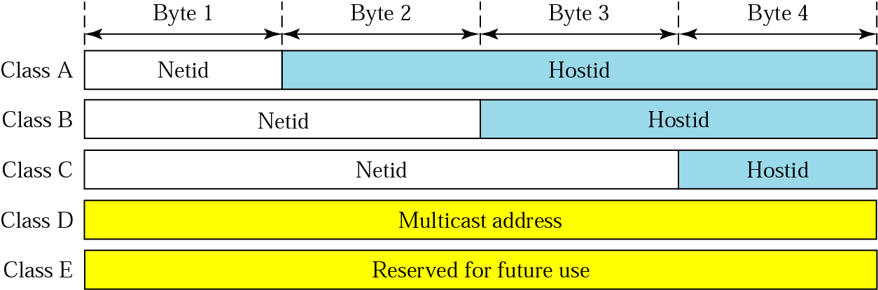
Netid and Hostid
Illustration of Net ID and Host ID parts of IP address
Carol Davids © 2009

Slide 36
Definitions of a special IPv4 address
Network Address also called the First Address is, by convention, the address of the network, but not the address of any device on the network
To discover the Network Address of any IP address, you set all the bits in the host portion of the address to 0.
Net ID
00000 …00
Carol Davids © 2009

Slide 37
Network Address or First Address
Network Address also called the First Address - the address of the network, but not of any device on the network
Net ID
00000 …00
Carol Davids © 2009

Slide 38
Network Broadcast Address
The network broadcast address is also not the address of any device on the network.
It can be found be setting all the bits in the host-id portion of the network address to 1.
Net ID
1111….11
Carol Davids © 2009

Slide 39
Practice with these definitions
Problem:
What is the address of the network on which the classful IPv4 address, 216.47.140.28, is found? What is the broadcast address of that network?
Answer:
Since the address is classful we look at the first byte, 216, and learn that it is a Class C address.
Thus, the network id portion of the address is: 216.47.140
And the host id portion of the address is: .28
Carol Davids © 2009

Slide 40
Practice with these definitions
Answer (continued):
Thus the Network address is 216.47.140.0
And the broadcast address is 216.47.140.255
Carol Davids © 2009

Slide 41
Another definition: Network Mask
Network Mask - a pattern of 32 bits whose format is a set of contiguous 1’s followed by a set of contiguous 0’s used by a router to determine the address of the network on which an IP address is located
Examples of network masks:
11111111 00000000 00000000 00000000
11111111 111111111 00000000 00000000
11111111 111111111 111111111 00000000
11111111 111111111 11100000 00000000
Carol Davids © 2009

Slide 42
Uses of the Network Mask
The router performs a binary AND operation whose inputs are (1) the network mask and (2) the destination IP address.
The output of the AND operation is the network address of the network on which the destination IP address is located.
Carol Davids © 2009

Slide 43
Definition of a Block of Addresses
To define a block of addresses it is necessary to give two pieces of information: (1) the network address and (2) the network mask.
In Classful addressing, we actually already know the network mask.
By definition, Class A addresses have network mask 11111111 00000000 00000000 00000000; Class B addresses have network mask 11111111 11111111 00000000 00000000
Carol Davids © 2009

Slide 44
Definition of a Block of Addresses
By definition:
Class A addresses have network mask 11111111 00000000 00000000 00000000
Class B addresses have network mask 11111111 11111111 00000000 00000000
Class C addresses have network mask 11111111 11111111 11111111 00000000
A simple treatment of these concepts is available at http://en.wikipedia.org/wiki/Classful_network.
Carol Davids © 2009

Slide 45
Memorize this information
First byte Class
0 - 127 A
128 - 191 B
192 - 223 C
224 - 239 D
240 - 255 E
Carol Davids © 2009

Slide 46
Routers and destination IP addresses
The Router uses a network mask to learn the network address of the destination host
If the destination host is identified by a class-full address, the router uses a “default network mask”
If the destination host is identified by a class-less address, the router uses the network mask identified by the /n at the end of the address.
Carol Davids © 2009

Slide 47
Routing Class-full addresses
The router applies a Default Network Mask to the destination address of the data packet it needs to route.
The default mask is a 32 bit binary number.
The router performs a binary AND of the default network mask with the IP address.
Which default mask will it apply?
That will depend on the value of the first 4 bits of the destination address.
Carol Davids © 2009

Slide 48
Default Network Mask
If the first bit is 0, the router applies the Class A default network mask.
  11111111 00000000 00000000 00000000
If the first 2 bits are 10, the router applies the Class B default network mask.
  11111111 11111111 00000000 00000000
If the first 3 bits are 110, the router applies the Class C default network mask.
  11111111 11111111 11111111 00000000
Carol Davids © 2009

Slide 49
Default Network Mask - Notation
On the next page there are three different notations shown for representing Class A, B and C default network masks.
Each one means the same thing.
Each one represents a number of contiguous 1’s to be ANDed with the IP address of the destination.
The result of the AND will leave the IP address of the network to which the packet should be sent.
Carol Davids © 2009

Slide 50
Class A default network mask.
  11111111 00000000 00000000 00000000
  255.0.0.0
  /8
Class B default network mask.
  11111111 11111111 00000000 00000000
  255.255.0.0
  /16
Class C default network mask.
  11111111 11111111 11111111 00000000
  255.255.255.0
  /24
Carol Davids © 2009

Slide 51
Example
You are a router. You receive an IP datagram with destination IP Address
  10111110 11110000 00000111 01011011
  (190.240.7.91)
Determine the network address to which the datagram should be sent.
Carol Davids © 2009

Slide 52
Example
Answer:
You read the first bit and it’s a 1.
So you need to read the second bit. It is 0.
That tells you this is a class B address.
You apply the default network mask for a class B address
11111111 11111111 00000000 00000000
Carol Davids © 2009

Slide 53
Example
The application of this mask yields:
10111110 11110000 00000000 00000000
Expressed in dotted decimal this is
190.240.0.0
The router looks to see if it has a next hop associated with the network whose address is 190.240.0.0
If it has, it sends the datagram to the interface associated with that next hop
Carol Davids © 2009

Slide 54
Example
If it does not, then it sends the datagram to the default router via the interface associated with that default router.
Carol Davids © 2009

Slide 55
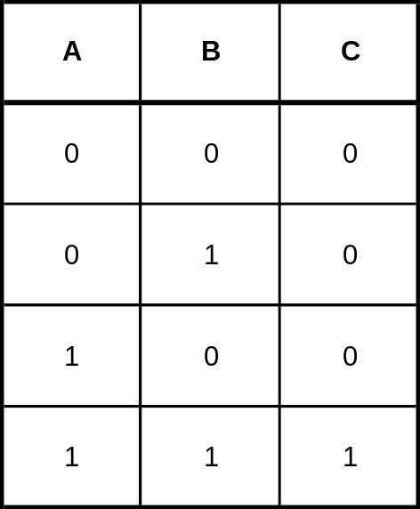
Review Logical AND
The truth table for the logical AND is shown below:
Columns A and B contain possible values of these inputs
Column C contains the corresponding output
Carol Davids © 2009

Slide 56
Special Addresses
0.0.0.0
255.255.255.255
<netid>.1111….11 (the number of binary 1's depends upon the class of the network if it is classful, or the number of bits in the hostid portion of the network if it is classless)
127.<anything>
Carol Davids © 2009

Slide 57
Special Address - booting
0.0.0.0
Used by hosts when they are booting.
May also refer to all the network interfaces that the machine has.
Carol Davids © 2009

Slide 58
Special Addresses - local (r local) broadcast address
255.255.255.255
A broadcast to all IP addresses on the local network.
An IP datagram addressed to this local broadcast address will not be forwarded by the router(s) on the network.
Carol Davids © 2009

Slide 59
Special Address - directed broadcast
<netid>.1111…11
A broadcast to all hosts on a particular network with network address <netid>0000…00
Routers may not forward or may refuse to broadcast to the destination network since this could be an attack on the destination network.
Carol Davids © 2009

Slide 60
Special Address - Loopback
127.<anything>
A loopback address.
Packets sent to this address are not put on the network.
They are processed locally and treated as incoming packets.
Carol Davids © 2009

Slide 61
Classless Interdomain Routing (CIDR)
Specified in RFC 1519
Provides a method for giving out a block of IP addresses without regard to Class.
Helps to control the growth of internet routing tables.
Today a lack of Class B IP Addresses is causing enterprises to need to buy several Class C Addresses.
Carol Davids © 2009

Slide 62
Classless Interdomain Routing (CIDR)
A CIDR Address is given in the form xxx.xxx.xxx.xxx/n
Here /n tells how many contiguous 1’s there are in the network mask
For the address xxx.xxx.xxx.xxx/11, the network mask is 11111111 11100000 00000000 00000000
Carol Davids © 2009

Slide 63
Classless Interdomain Routing (CIDR)
For the IP Address xxx.xxx.xxx.xxx/21 the network mask is
11111111 11111111 11111000 00000000
Carol Davids © 2009

Slide 64
Classless Interdomain Routing (CIDR)
Apply the CIDR representation to the classfull addresses we have just learned:
Class A -> /8
Class B -> /16
Class C -> /24
Carol Davids © 2009

Slide 65
CIDR Terminology
Prefix - the high-order (n) bits of a CIDR IP Address, xxx.xxx.xxx.xxx/n
Suffix - the low-order (32-n) bits of a CIDR IP Address, xxx.xxx.xxx.xxx/n
Prefix
Suffix
Carol Davids © 2009

Slide 66
CIDR Terminology
First Address - the IP address formed by replacing the suffix by binary 0’s
Last Address - the IP address formed by replacing the suffix by binary 1’s
Carol Davids © 2009

Slide 67
Classless InterDomain Routing (CIDR)
CIDR allows an organization to receive a block of IP addresses closer to the number it actually requires.
There are 3 requirements placed on the size of the block:
  The addresses must be contiguous
  The number of addresses must be a power of 2
  The first address must be divisible by the number of addresses
Carol Davids © 2009

Slide 68
CIDR address example 19.6
Problem:
A block of addresses is given to a small organization. One of the addresses is 205.16.37.39/28. What is the first address of the block?
Solution:
The network mask is:
11111111 11111111 11111111 11110000
Place the network mask over the address you are given:
205.16.37.<00100111>AND<11110000>
39 240
Carol Davids © 2009
Notes:
중요함
How many total ip formatted addressing on the net work
114 34 75 45 /22 2^(32-22) = 2 ^10
114 34 72 0 first address 114 34 75 45 114 34 75 255 last address

Slide 69

CIDR address example 19.6
205.16.37.<00100111>AND<11110000>
This is 205.16.37.00100000 or
205.16.37.32 is the first address of the block
The block itself is illustrated below.
Carol Davids © 2009

Slide 70
CIDR address example 19.7
Problem:
Find the last address in example 19.6.
Solution:
Set all the host bits to 1’s.
The right-most 4 bits are the host bits.
205.16.37.<00100111> is the address we are given
Set the right-most 4 bits to 0 to get 205.16.37.<00101111>
205.16.37. <32+15> or
205.16.37.47
Carol Davids © 2009

Slide 71
CIDR address example 19.8
Problem:
How many addresses are there in the block of addresses in which the address 205.16.37.39/28 is found?
Solution:
The first address is 205.16.37.32
The last address is 205.16.37.47
There are 16 addresses in the block.
You can calculate this as follows:
There are 28 bits needed to identify the network portion.
Carol Davids © 2009

Slide 72
CIDR address example 19.8
There are a total of 32 bits in an IP address.
Therefore there are 32-28 = 4 bits used to identify the hosts on this network.
Each bit can take on one of two values, 0 or 1.
Thus there are a total of 2⁴ = 16 different hosts on this network.
Carol Davids © 2009

Slide 73
CIDR address example
Problem:
Is it possible that 180.34.25.200/26 could be the first address of a CIDR network?
Solution:
(1) How many addresses are in the block of addresses to which this address belongs?
32-26 = 6; 2⁶ = 64; so there are 64 possible addresses
Carol Davids © 2009

Slide 74
CIDR address example
(2) Write this CIDR address as a decimal value:
180 x 256³ + 34 x 256² + 25 x 256¹ + 200 x 256⁰
3019898880 + 2228224 + 6400 + 200 = 3022133704
(3) Divide the decimal value you just calculated by the number of possible addresses:
3022133704 / 64 = 47220839.13
So, the candidate first address is not divisible by the total number of addresses
So it is not in fact the first address on the CIDR network on which it is located.
Carol Davids © 2009

Slide 75
Sub-networks
Sub-networks allow you to subdivide your network into administrative units
You do not gain addresses
You do gain administrative control
Sub-networks are defined in RFC 950.
Sub-networking divides the host portion of the IP Address into a Subnet ID and a Host ID.
Carol Davids © 2009

Slide 76

Sub-networks: How they work
You get your IP Network ID from the ICANN - the Internet Corporation for Assigned Names and Numbers or from one of its delegated organizations.
Then you are free to subdivide the host bits as you choose.
Host portion of the IP address
Carol Davids © 2009

Slide 77
Sub-networks: Example 1
You are assigned 140.253.0.0
This is a Class B address - since 140 is between 128 and 191 and there is no slash.
So you have 16 bits of the IP Address to allocate as needed.
You can choose to use the first 8 bits of the host portion to identify all your subnetworks.
140.253.xxx.xxx
Carol Davids © 2009

Slide 78
Sub-networks: Example 1
That would allow to build 2⁸ = 256 subnetworks.
Then each of those subnetworks could have 2⁸ -2 or 254 hosts associated with it.
(Minus 2 because the ‘all zeros’ and the ‘all ones’ addresses have special meaning and are not assigned to individual hosts.)
Carol Davids © 2009

Slide 79
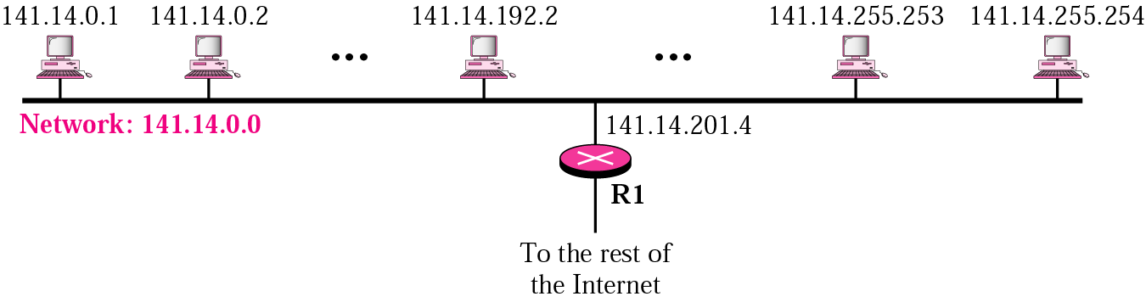
Network without subnetworks
Two levels of hierarchy.
Internet and LAN.
All messages to 141.14.0.1 thru 141.14.255.254 from the rest of the Internet are routed to R1’s external interface x.y.z.t/n
x.y.z.t/n
Carol Davids © 2009

Slide 80
Network without subnetworks
Note that R1 has two interfaces.
It’s LAN interface has one of the IP addresses assigned to the LAN.
It’s external interface has an IP address x.y.z.t/n
x.y.z.t/n is an IP address on the WAN.
x.y.z.t/n
Carol Davids © 2009

Slide 81
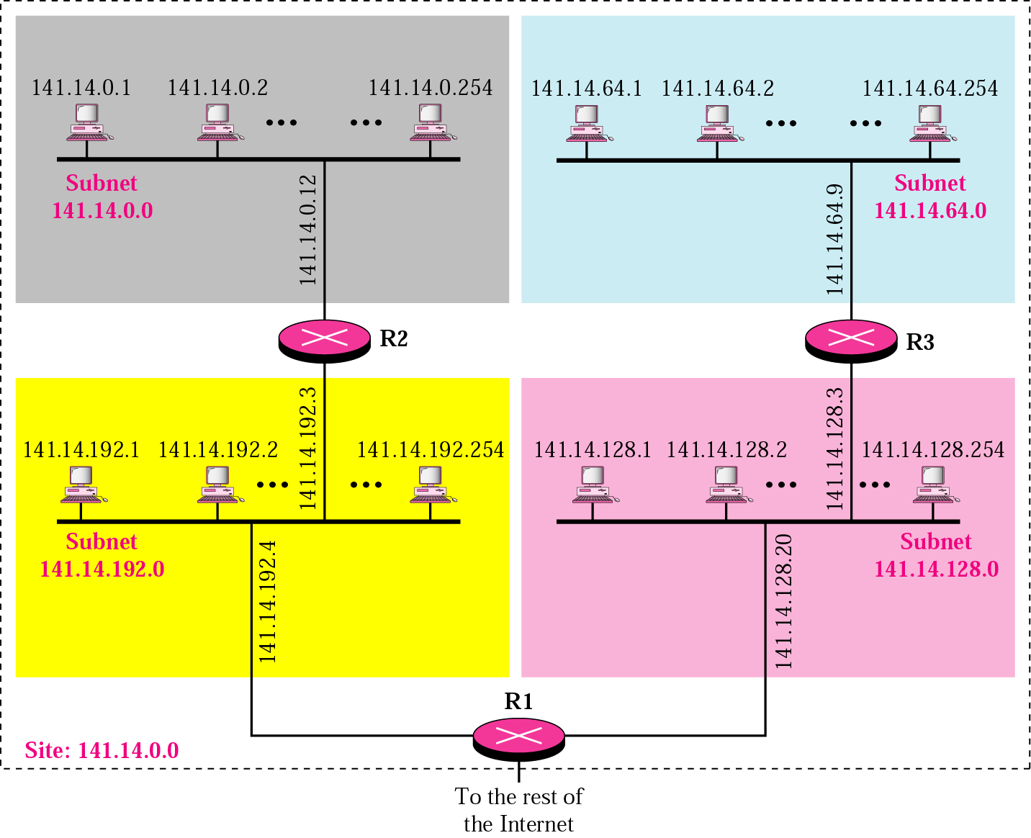
Network with subnetworks
Three levels of hierarchy. Internet, Site, Subnetworks.
Carol Davids © 2009

Slide 82
Network with subnetworks
In the illustration on the previous page, the routers on The Internet do not know about the subnets.
They find the router R1 by applying their default network mask to the address of any host on the Network 141.14.0.0.
Carol Davids © 2009

Slide 83
Network with subnetworks
The Site administrator has defined the following four subnetworks:
141.14.0.0 (*)
141.14.64.0
141.14.128.0
141.14.192.0
* This subnetwork address is also the network address of the network. The network administrator decides whether to use this address to identify a subnetwork.
Carol Davids © 2009

Slide 84
Network with subnetworks
The sub-networks are:
141.14.0.0 10001101 00001110 00000000 00000000
141.14.64.0 10001101 00001110 01000000 00000000
141.14.128.0 10001101 00001110 10000000 00000000
141.14.192.0 10001101 00001110 11000000 00000000
Notice that 4 subnets were created and we used the two high-order bits of the host portion of the network address to create these subnetworks.
Carol Davids © 2009
Notes:
25 38 14 192 / 26
FIRST 25 38 14 192
LAST 25 38 14 207

Slide 85
Network with subnetworks
The sub-network mask for this Site is:
11111111 11111111 11000000 00000000
The router R1 applies this subnet mask to the destination addresses of incoming datagrams to determine which router to forward the datagrams to.
Carol Davids © 2009
Notes:
별도 예제
216.47.121.0 NETWORK ADDRESS
CLASS C
11111111 11111111 11111111 00000000 NET WORK MASK
TOTAL 2^8 256 ADDRE/9SSES USEFUL 254-----------------------------MASK 8 SUBNETWORK 0/32/64/96/128/160/192/224 -> 32IP ADDRESS IN EACH

Slide 86
Example 2: Network with subnetworks
Let’s choose a different subnet mask for the network 141.14.0.0:
11111111 11111111 11100000 00000000
List all the subnets that can be created using this mask:
Carol Davids © 2009

Slide 87
subnetworks
<netid>. 00000000 00000000
<netid>. 00100000 00000000
<netid>. 01000000 00000000
<netid>. 01100000 00000000
<netid>. 10000000 00000000
<netid>. 10100000 00000000
<netid>. 11000000 00000000
<netid>. 11100000 00000000
Carol Davids © 2009

Slide 88
Network with subnetworks
141.14.0.0 0000000 00000000
141.14.32.0 0010000 00000000
141.14.64.0 0100000 00000000
141.14.96.0 0110000 00000000
141.14.128.0 1000000 00000000
141.14.160.0 1010000 00000000
141.14.192.0 1100000 00000000
141.14.224.0 1110000 00000000
Here we show the all 0’s and all 1’s addresses in red. Some administrators choose not to use them to identify subnetworks.
Carol Davids © 2009

Slide 89
All 0’s and all 1’s subnetworks
See reference below for Cisco’s explanation of why, historically, it was not recommended to use the all-0’s and all-1’s as subnetworks
http://www.cisco.com/en/US/tech/tk648/tk361/technologies_tech_note09186a0080093f18.shtml
Carol Davids © 2009

Slide 90
Sub-networks: Example 3
You are assigned 140.253.000.000 (a Class B network). So you have 16 bits of the IP Address to allocate as needed.
You have 10 departments on this corporate network and you want each one of them to have its own sub-network.
Carol Davids © 2009

Slide 91
Sub-networks: Example 3
Represent all the possible IP addresses on the network you were given as 140.253.xxx.xxx
You may use the xxx.xxx, 16 bits, any way you want
Carol Davids © 2009

Slide 92
Sub-networks: Example 3
First, determine how many bits you will need to identify 10 different Subnet IDs.
10 expressed as a binary number is 1010.
This means you need 4 bits to uniquely identify 10 subnets.
140.253.xxx.xxx is the decimal representation
<net id>.xxxxxxxx.xxxxxxxx is the binary representation
Carol Davids © 2009

Slide 93
Sub-networks: Example 3
<net id>.xxxxxxxx.xxxxxxxx, take the first four bits of the <host id> and use them to define your subnetworks.
<net id>.0000xxxx.xxxx is the 0 subnet
<net id>.0001xxxx.xxxx is the next subnet
<net id>.0010xxxx.xxxx is the next subnet
<net id>.0011xxxx.xxxx is the next subnet
Carol Davids © 2009

Slide 94
Sub-networks: Example 3
140.253.<xxxxxxxx>.<xxxxxxxx>
140.253.<0000 0000>.<0000 0000> = 140.253.0.0
140.253.<0001 0000>.<0000 0000> = 140.253.16.0
140.253.<0010 0000>.<0000 0000> = 140.253.32.0
140.253.<0011 0000>.<0000 0000> = 140.253.48.0
140.253.<0100 0000>.<0000 0000> = 140.253.64.0
140.253.<0101 0000>.<0000 0000> = 140.253.80.0
140.253.<0110 0000>.<0000 0000> = 140.253.96.0
140.253.<0111 0000>.<0000 0000> = 140.253.112.0
Continue this as an exercise
There are 16 possible subnetworks, of which you might choose to use only 14.
Carol Davids © 2009

Slide 95
Subnet Mask
When a host boots it reads its IP address from a file stored on disk.
It also reads its subnet mask.
The subnet mask is a 32 bit value - just like the IP Address itself.
Carol Davids © 2009

Slide 96
Subnet Mask
The subnet mask fits right over the IP Address.
It contains 1’s for every bit position associated with its network address and subnet ID.
It contains 0’s for every bit position associated with its host ID.
Carol Davids © 2009

Slide 97
More Examples
Problem 1:
Find the mask that creates 6 subnets in class A.
Solution:
We have xxxxxxxx xxxxxxxx xxxxxxxx host bits to make subnets out of.
We need to make a total of 6 subnets.
  2 to the ? Is greater than or equal to 6?
  2² = 4 so 2 bits is not enough
  2³ = 8 so 3 bits is enough
Carol Davids © 2009

Slide 98
Problem 2:
An organization has the network address 190.240.0.0.
A router outside the organization receives a packet with destination address 190.240.7.91.
Show how the router finds the network address to which to route the packet.
Carol Davids © 2009

Slide 99
The router proceeds as follows:
The router looks at the first byte of the address to find the class. It is class B.
The default mask for class B is 255.255.0.0.
The router puts this mask over the destination address to get 190.240.0.0. (the binary operation is called AND)
The router looks in its routing table to find a match for the network address.
When it finds the match it learns the identity of the Interface out which to send the packet.
Carol Davids © 2009

Slide 100
Problem 3:
A router inside the organization receives a packet with destination address 190.240.33.91.
The subnetwork mask is /19.
Show how the router finds the subnetwork address to route the packet.
Carol Davids © 2009

Slide 101
The router proceeds as follows:
The subnetwork mask is /19.
Its binary representation is 11111111 11111111 11100000 00000000.
The router applies the subnet mask to the address, 190.240.33.91.
We need to calculate (11100000 AND 00100001).
The result is 00100000.
So the subnet address is 190.240.32.0.
The router looks in its routing table to find a match for the subnetwork address.
When it finds the match it learns the identity of the Interface out which to send the packet.
Carol Davids © 2009

Slide 102
Private Addresses and NAT
The Internet Assigned Numbers Authority (IANA) has reserved the following three blocks of the IP address space for private use.
Addresses for private use:
10.0.0.0 - 10.255.255.255 (class A)
172.16.0.0 - 172.31.255.255 (class B)
192.168.0.0 - 192.168.255.255 (class C)
Carol Davids © 2009

Slide 103
Private Addresses and NAT
Addresses for use inside a network:
10.0.0.0 - 10.255.255.255 (class A)
172.16.0.0 - 172.31.255.255 (class B)
192.168.0.0 - 192.168.255.255 (class C)
Carol Davids © 2009

Slide 104
Private Addresses and NAT
The first block is a single class A network number
The second block is a set of 16 contiguous class B networks
The third block is a set of 255 contiguous class C networks.
Carol Davids © 2009

Slide 105
1 Class A Block of Private Addresses
Class A network IP address range
10.0.0.0 - 10.255.255.255
For each block:
  Network mask = 255.0.0.0
  Network address length = 8 bit
  Host address length = 24 bit
Carol Davids © 2009

Slide 106
16 Class B Blocks of Addresses
16 Class B Blocks of private addresses
172.16.0.0 - 172.16.255.255
172.17.0.0 - 172.17.255.255
172.18.0.0 - 172.18.255.255
...
172.31.0.0 - 172.31.255.255
For each of the 16 Class B bocks:
Network mask = 255.255.0.0
Network address length = 16 bit
Host length = 16 bits
Carol Davids © 2009

Slide 107
256 Class C Blocks
256 Class C Private Address Blocks:
192.168.0.0 - 192.168.0.255
192.168.1.0 - 192.168.1.255
192.168.2.0 - 192.168.2.255
...
192.168.255.0 - 192.168.255.255
For each of the 256 Class C Blocks:
Network mask = 255.255.255.0
Network address = 24 bit
Host address = 8 bit
Carol Davids © 2009

Slide 108
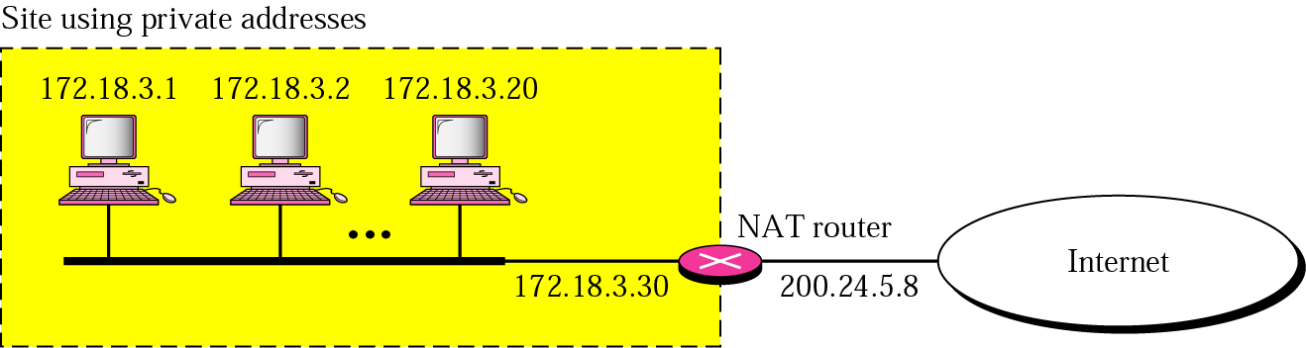
NAT : Network Address Translation
Figure below Illustrates the use of private addresses
Carol Davids © 2009

Slide 109
NAT : Network Address Translation
Figure below Illustrates the use of private addresses
Carol Davids © 2009

Slide 110
NAT : Network Address Translation
NAT allows the owner of a network to assign IP addresses to the hosts and routers on his/her network without asking ICANN for the addresses.
The address spaces that the network owner may use are the Private Address spaces we just described.
Carol Davids © 2009

Slide 111
NAT : Network Address Translation
If the network owner wants to assign 100 IP addresses from a private address space, the addresses can be routed internally on his/her network.
But if a host with a private IP address needs to send an IP datagram to a computing device on the public Internet, that host needs to have a source address that is routable on the Public Internet.
Carol Davids © 2009

Slide 112
NAT : Network Address Translation
A function called a Network Address Translator is needed to translate the private IP address to a public IP address.
The translation is done using a table look-up.
Different types of look-up can be used.
Carol Davids © 2009

Slide 113

NAT : Network Address Translation
All the outgoing datagrams go through the NAT.
The NAT replaces the source address with the external public address of the NAT.
Carol Davids © 2009

Slide 114

NAT : Network Address Translation
When the destination sends a reply to the originating device, the destination address in the reply message is the public address that the NAT added – not the private address.
Carol Davids © 2009

Slide 115
NAT : Network Address Translation
When the NAT receives this reply, it needs to determine which of the hosts on its private network is the final destination.
NATs can use different types of tables to do this.
Carol Davids © 2009

Slide 116
NAT : Network Address Translation
The translation table can use various methods
Single IP address method:
  The translation table notes the destination address of the outgoing packet. When an IP datagram arrives which has that address as a source, the router forwards the datagram to the correct private address.
  The illustration on the next page uses public address of NAT router 200.24.5.8.
Carol Davids © 2009

Slide 117
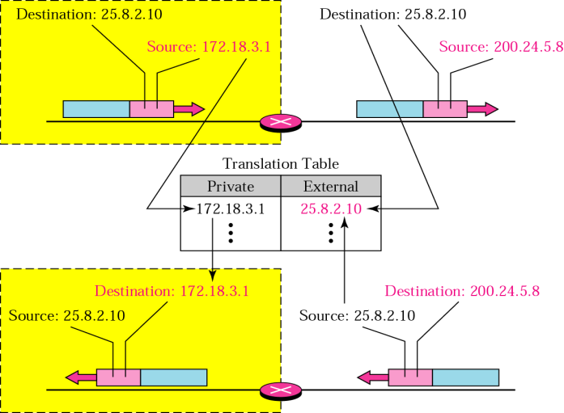
NAT : Single IP address method:
In this illustration, only one host on the private network can have a communication with a device on the public network at any time.
Carol Davids © 2009

Slide 118
NAT : Pool of IP addresses
Pool of IP Addresses:
  The NAT router has a pool of X public addresses.
  This allows X different private addresses to connect to external addresses
Private | External
172.18.3.1 | 25.8.3.2
172.18.3.9 | 25.8.3.3
 | 25.8.3.4
Carol Davids © 2009

Slide 119
NAT: map IP and port
Combination of IP Addresses and Transport Ports;
  The NAT uses a 5 column translation table. The columns are:
    Private address
    Private port
    External address
    External port
    Transport protocols
Carol Davids © 2009

Slide 120

NAT : Network Address Translation
Combination of IP Addresses and Transport Ports
Carol Davids © 2009

Slide 121
The End
Carol Davids © 2009

Slide 122
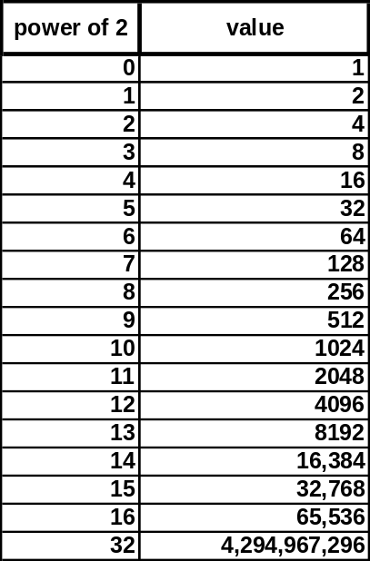
Binary Reference 1
Carol Davids © 2009

Slide 123
Binary Reference 2
Binary, Hex and Decimal Numbers
        Binary 1 1 0 1 1 0 0 1
        Hex d 9
        Decimal 221
Carol Davids © 2009

Slide 124
Binary Reference 3
How many combinations of three bits are there?
2**3 = 8
        0 0 0
        0 0 1
        0 1 0
        0 1 1
        1 0 0
        1 0 1
        1 1 0
        1 1 1
Carol Davids © 2009

